Slide 1
Economic Inequality Undermines the Sharing Economy Experiment designs from pp. 8 For the detailed results, please refer to the pdf file.
Jinyan Xiang, Mario Pandelaere

Slide 2
“An economic model based on sharing under-utilized assets between peers without the transfer of ownership, ranging from spaces, to skills, to stuff, for monetary or non‐monetary benefits via an online mediated platform”
Huurne et al., (2015, p486)

Slide 3









ride-sharing
car-sharing
p2p lending
lodge-sharing
park-sharing
p2p food-delivery

Slide 4


$15 billion
$335 billion
2,133%
market size in 2014
market size in 2025
INCREASE!

Slide 5
Research Motivation
Antecedents of Consumers’ Engagement in the Sharing Economy
EXTRINSIC MOTIVES¹
Economic benefits
Costly Signals
DEMOGRAPHICS³
Gender
Education
Income
INTRINSIC MOTIVES²
Sustainable concern
Hedonic values
Social responsibility
COMMUNICATION TACTICS⁴
Provider-focused vs. platform focused.
1 & 2. Benoit et al. (2017); Hamari et al. (2015); Lamberton (2016);
3. Lutz and Newlands (2018);
4. Costello and Reczek (2020)

Slide 6
Research Motivation
the previous research
the current research
INDIVIDUAL-level factors
(e.g., extrinsic/intrinsic motivations, demographics, empathy in providers)
USER-centric
A fundamental SOCIOECONOMIC factor:
economic inequality
USER’s and PROVIDER’s perspectives
PLATFORM characters¹
(con-sociality & intermediation)
1. Perren and Kozinets (2018)

Slide 7
Theoretical Background
The consumer’s (i.e., trustor) willingness to be vulnerable to a user or a provider (i.e., trustee) in a sharing incident¹
lower perceived trustworthiness of people who are perceived to have individualistic, competitive, and conflictive mindsets and behave aggressively² (due to intensified status competition³, and a heightened sense of relative deprivation⁴
…
reduce perceived uncertainties and risks associated with interacting with strangers⁵
…
Interpersonal
Trust
(in the region’s people-users or providers)
Engagement in the Sharing Economy
(with the region’s people)
Economic inequality
(in a region)
1. adapted from Mayer, Davis and Schoorman (1995)
2. John, Loewenstein and Rick (2014); Nishi et al. (2015)
3. Wilkinson and Pickett (2017)
4. Greitemeyer and Sagioglou (2016)
5. Pavlou (2003)

Slide 8
Empirical Evidence
Studies Overview
Archival data analysis
(N = 83,115)
P2P lending
(e.g., Prosper)
Experiments
(N _{total} = 876)
P2P lending
Lodge-sharing
(e.g., Airbnb)
Ride-sharing
(e.g., Uber)
methods
contexts
perspectives
contribution
to the sharing economy
use
of the sharing economy

Slide 9
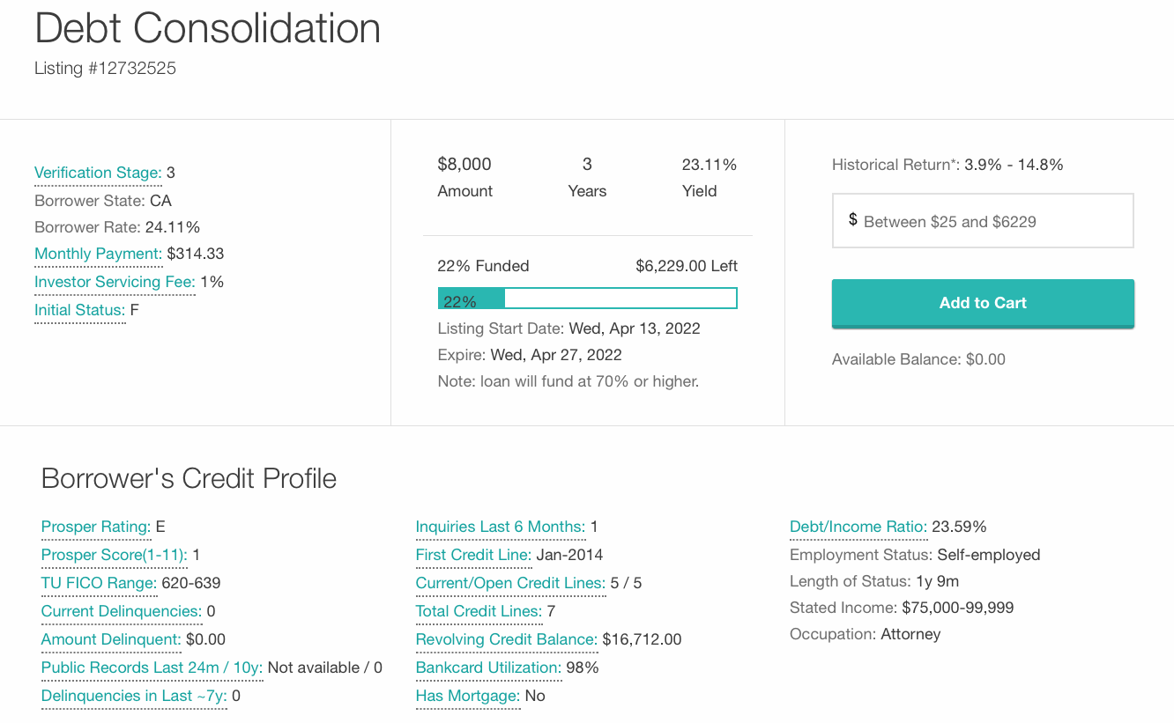
Archival data analysis
cue of borrower’s trustworthiness
Prediction: on average, lenders would lend less to a borrower if the borrower is from a more unequal state due to lower interpersonal trust
83,115 unique
fully-funded listings
from07/2009 to 03/2014
in 48 different states
(excluding Iowa, Maine, & North Dakota)

Slide 10
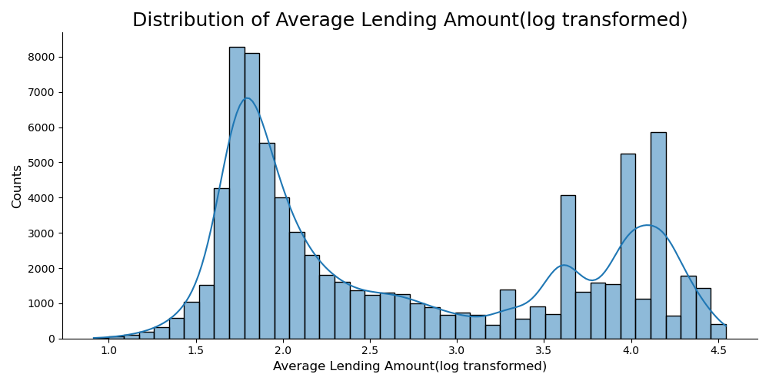
Archival data analysis

Slide 11
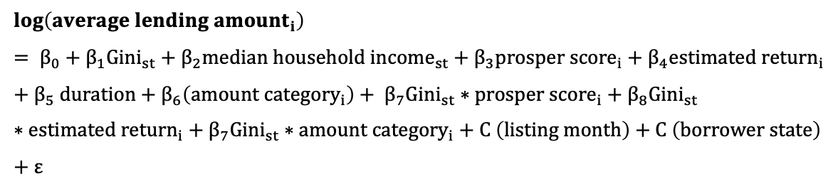
Archival data analysis
*src: Census Bureau
**calculation of proposer score
$$\log\left({average lending amount}_{i}\right)= β_{0}+β_{1}{Gini}_{st}+β_{2}median household {income}_{st}+β_{3}prosper {score}_{i}+β_{4}estimated {return}_{i}+β_{5} duration+β_{6}\left(amount {category}_{i}\right)+ β_{7}{Gini}_{st}∗prosper {score}_{i}+β_{8}{Gini}_{st}∗estimated {return}_{i}+β_{7}{Gini}_{st}∗amount {category}_{i}+C \left(listing month\right)+C \left(borrower state\right)+ε$$
i denotes listing (N =80,937)
s denotes state (N = 48)
t denotes year (N = 5, 2010-2014)
m denotes month (N = 50, 02/2010 – 03/2014)
Gini*
(list year & borrower’s state)
median household income*
(inflation-adjusted in 2019 USD)
DV
IV (-)
State-level Covariate
Listing-level Covariates
Interactions
fixed effects
Prosper Score**: a custom risk score built using historical Prosper data (1-11)
Estimated Return = Estimated Effective Yield – Estimated Loss
Duration = The date when fully funded – the date when listed
Amount Category = small lending amount (<= 1k) vs. large lending amount
Average Lending Amount for each listing
= loan original amount / N of investors
& log-transformed to address the skewness

Slide 12
Experiment 1 – design & procedure
Scenario
Stay in Bimboola [Hypothetical] for 3 months for business purposes
The company would provide two accommodation options (comparable in quality, room structure, and reimbursement): 1. a local lodge-sharing service 2. a local hotel
Manipulation of
economic inequality
mock Google search page
DVs
Willingness to choose the lodge-sharing service over the hotel if the cost is equal (1- 7)

Slide 13
Experiment 2
Scenario & Stimuli
invest in an international p2p platform & mock listing
midpoint

Slide 14
Experiment 2
Scenario & Stimuli
invest in an international p2p platform & mock listing
Manipulation of economic inequality: income distribution
(adapted from Payne et al. 2017, PNAS)
Mediator: interpersonal trust
Trust: how much would you trust Bimboolian people (1-7)
Trust: how trustworthy do you think Bimboolian people would be (1-7)
DVs
Lending amount (0 – 3000, incremental by 300)
Willingness to lend to this borrower over others(1-7)
Manipulation checks

Slide 15
Experiment 3a
Scenario
Travel to Bimboola for business
Manipulation of economic inequality: income distribution
(adapted from Payne et al. 2017, PNAS)
DV
Willingness to choose the local ride-sharing service over other transportation when heading to the office from the airport (1-7)
HIGH INQUALITY
Focal Mediator: as in Study 2
Alternative mediator: safety – how safe do you think Bimboola would be (1-7)
Manipulation checks

Slide 16
Experiment 3b
Scenario
Travel to Bimboola for business
Manipulation of economic inequality: images of street views
(adapted from Waldfogel et al. 2021, PNAS)
Manipulation checks
Focal Mediator: as in Study 2
Alternative mediator: safety – how safe do you think Bimboola would be (1-7)
HIGH INQUALITY
DV
Willingness to choose the local ride-sharing service over other transportation when heading to the office from the airport (1-7)

Slide 17
Familiarity as the moderator
Familiarity
(with the region’s people)
a precondition of trust
leads to liking and positive expectation of others’ trustworthiness¹
increases people’s confidence in others’ trustworthiness²
Interpersonal
Trust
(in the region’s people-users or providers)
Engagement in the Sharing Economy
(with the region’s people)
Economic inequality
(in a region)
from the provider’s perspective (S1,3) from the user’s perspective (S2,4)

Slide 18
Experiment 4 (data collection in progress)
Scenario
Imagine being a host of Airbnb
Received the service request from a Bimboolian guest
Manipulation of
economic inequality
similar to Study 1 (text only)
DVs
Willingness to serve to host
Readiness to accept this guest as a guest (1- 7)
Manipulation of
familiarity
guest’s history
Mediator
as in Studies 2, 3a & 3b
Low: you NEVER served any Bimboolian guests before
High: you have served SEVERAL Bimboolian guests before
Manipulation checks

Slide 19
Conclusions
Economic inequality lowers interpersonal trust, which discourages consumers from engaging in (contributing to and using) the sharing economy.
With various manipulations and measures of economic inequality
In different contexts/forms of the sharing economy
The negative effect of economic inequality is expected to be moderated by familiarity.

Slide 20

Conclusions
Economic inequality may undermine the development of the sharing economy in the long run.
Economic inequality may cause implicit discrimination and exclusion against providers and users from (highly) unequal regions.
How to intervene?

Slide 21
Supplementary Materials
Detailed cover stories of E1, E3a & 3b
Imagine that you work for an international company and are recently assigned to work in a foreign branch for three months. The foreign branch is located in Bimboola, a pacific island country.
Before you leave for Bimboola, you are interested in knowing this country.
Therefore, you searched it on Google, and Google returned the following results. (E1)
Therefore, you search it on Google, and the first webpage is about income distribution in Bimboola. You open this webpage and read the following information (E3a).
Therefore, you search it on Google, and you see some street images of Bimboola (E3b).

Slide 22
Supplementary Materials
Detailed cover stories of Study 2
Fund.com is an international peer-to-peer lending platform where borrowers and lenders come from different countries. On fund.com, borrowers ask for money from lenders, and lenders will receive the principal (i.e., the money they lend) and the interest/return when the borrower pays back. Most borrowers pay back in time; however, some borrowers may not pay back and unregister on the platform, in which case, it is hard for the lender even to receive the principal. The platform does not have any liability to compensate the lender’s loss.
You are considering investing in and making some money on fund.com as a lender, and the total amount you would like to invest is $10,000. In other words, you can allocate the $10,000 to different borrowers. As a lender, you can browse different loan request listings. The term of all requests on fund.com is one year, and the annual return for lenders is 10% (equal to the yearly interest rate) for all requests.
You see a new loan request listing. You also notice the borrower is from Bimboola, a pacific island country.
You do not know this country before. Therefore, you search it on Google, and the first webpage is about income distribution in Bimboola. You open this webpage and read the following information.

Slide 23
Supplementary Materials
WILLINGNESS TO BE A HOST
F(1,192) = 7.37
p = .007
η² = .037
F_{int}(1,192) = 2.60
p = .109
η² = .013
Familiarity with the region: newcomer vs. life-long resident

Slide 24
Supplementary Materials
*how much would you willing to pay for the lodge-sharing service, given the comparable hotel costs $150 per night
F(1, 195) = 6.52
p = .011
η² = .032

Slide 25
Supplementary Materials
F(1, 160) = 32.44, p < .001, η² = .17
F(1, 160) = 2.50, p = .115, η² = .02
*Conservative Test

